Slide 1
Social Media Scraping
Guided By:- SUBMITTED BY:-
Prof. Priyanka Jhangde Nilesh Barod (74)
Nitesh Parmar (75)
Pradhumn Sisodia (81)
Ravi Gehlot (85)
Sachin Patidar(92)

Slide 2
Introduction
What is Social Media Scraping?
Social Media Scraping is a software technique of extracting information from social media.
Through social media scraping all the user data is scraped and stored and verified in a centralized data bank. The aim is to collect, store and analyse data.
Most of the popular social networking sites such as Instagram , Facebook let crawlers extract data only through their own API, so as to control the amount of information about their users and their activity.

Slide 3
Social Network Used
Facebook
Linkedin
Instagram

Slide 4
Fetching Data from Facebook:
Public Posts
Public Photos
User Timeline
Tagged Photos
Friend list

Slide 5
Fetching Data from Linkedin
Work Profile of User
Connections
Achievements
Qualification details
Experience

Slide 6
Fetching Data from Instagram
Profile of User
Followers and Following
Posts
Story
Video

Slide 7
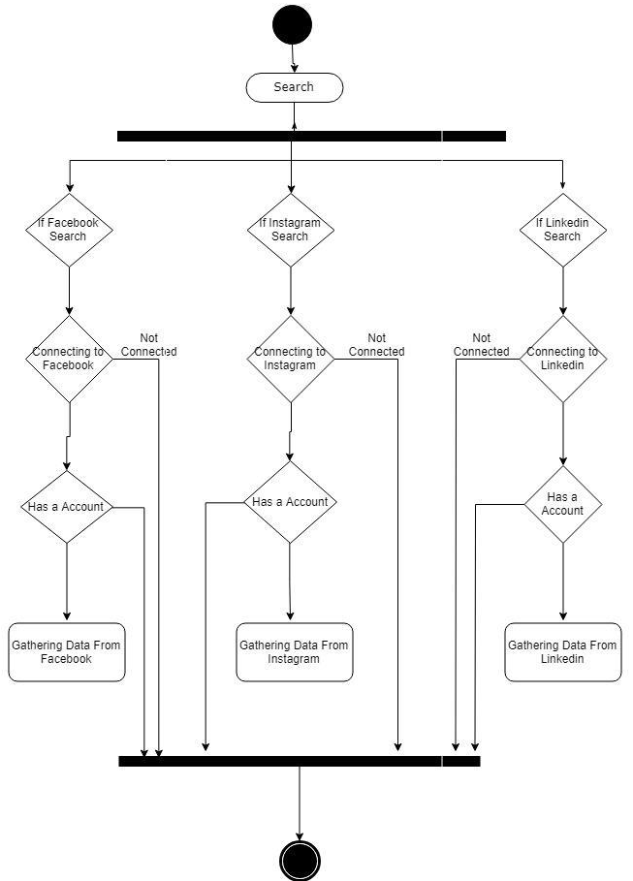
Diagrams:- Activity :-

Slide 8
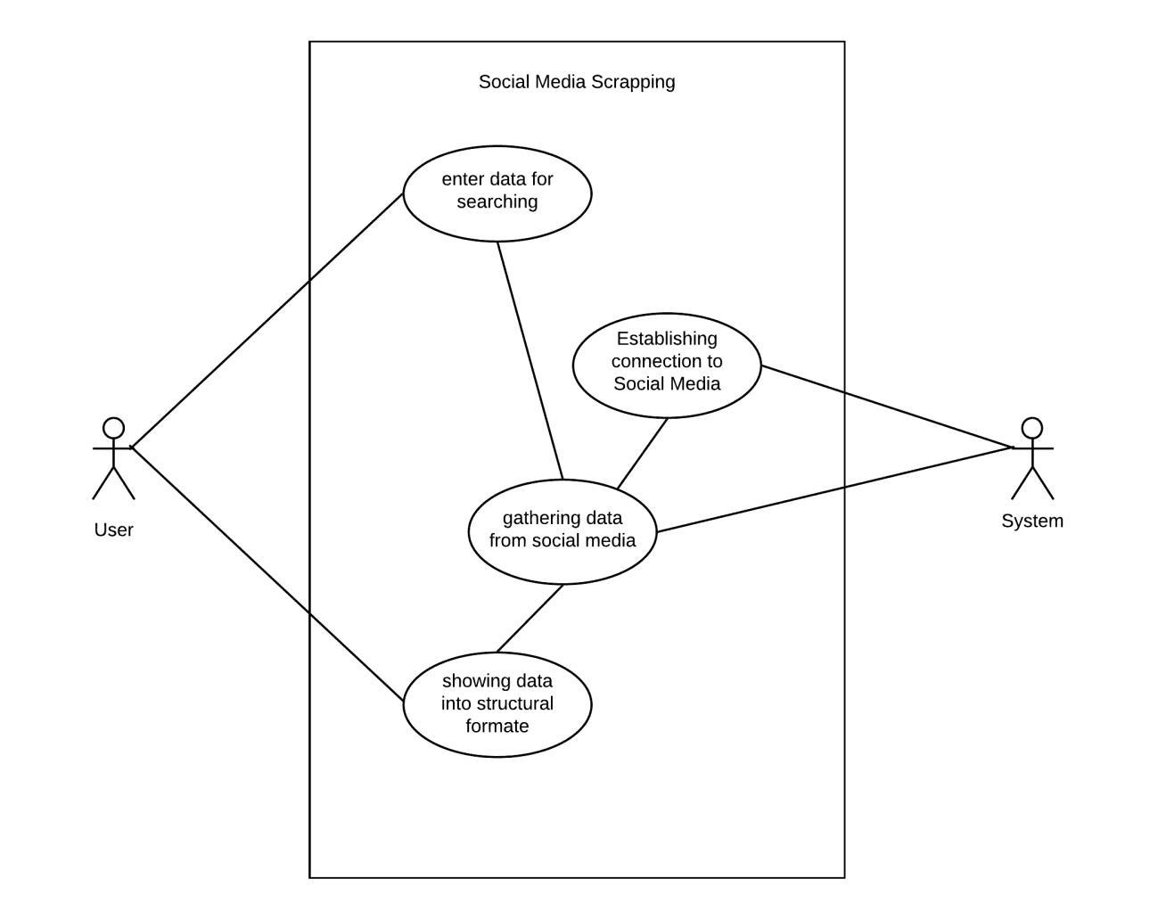
Use Case:-

Slide 9
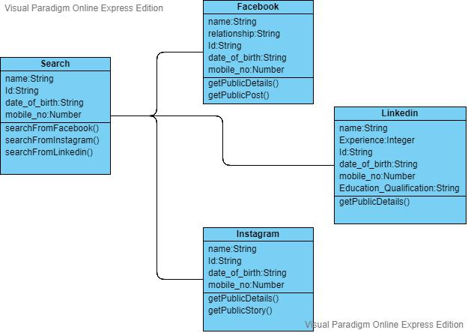
Class :-

Slide 10
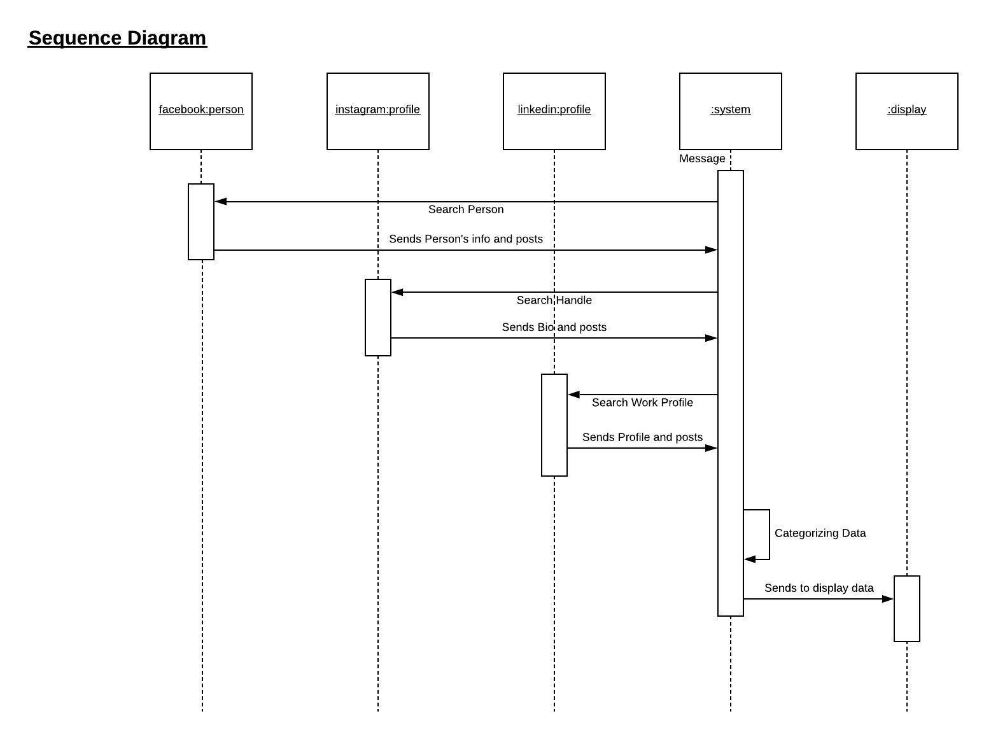
Sequence :-

Slide 11
Technology Used
Social media APIs
Python
Selenium

Slide 12
Conclusions:-
Web scraping and tools and techniques facing many challenges as the extraction of the data are not that easy. These techniques ensure that the gathered information is accurate, reliable and having higher confidentiality as the data present is in huge amount which is difficult to manage and maintain. Even though techniques useful there are some challenges faced that may be such as the high volume of web scraping can cause regulatory damage to the pages. The Level of source complexity in case if the information being extracted is very complicated web scraping will also be paralyzed

Slide 13
Challenges
External sites can change without warning
Different social sites have different security policies.
Changes can break scrapers easily
Bad HTTP status codes
example: using 200 OK to signal an error
cannot always trust your HTTP libraries default behavior

Slide 14


